Slide 1
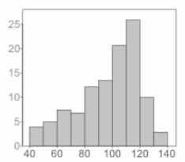
SQuAD Question Answering
Imbalance
Gagan Gopinath, Sai Raghava Mukund, Tarun Anand

Slide 2

Introduction
What is Question Answering?
Why is it important ?
Types of Question Answers
Notes:
Just like teaching or giving context and asking questions to students in order to check their understanding
machine comprehension of human language.

Slide 3
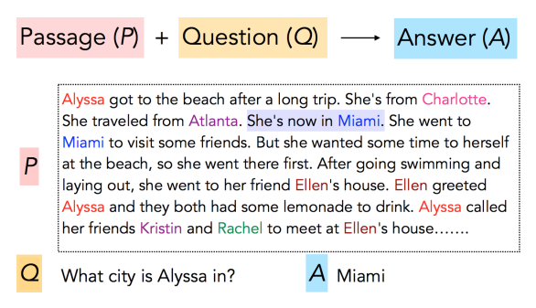
Task

Slide 4
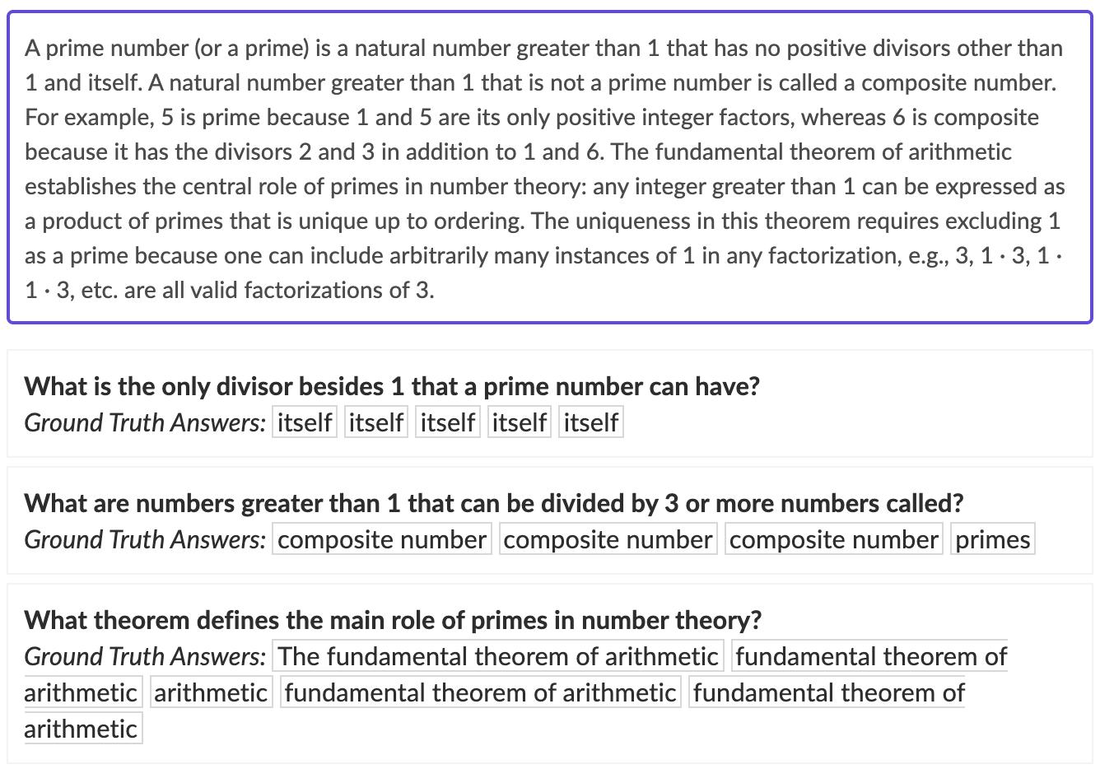
SQuAD

Slide 5
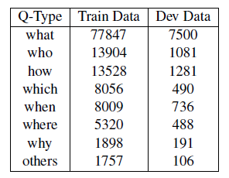
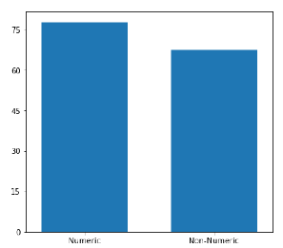
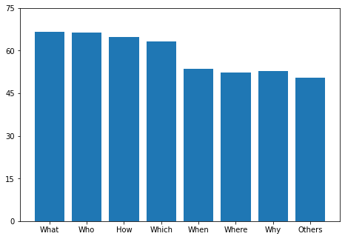
Motivation
Doesn’t work well in real-world scenarios
All questions - equally important
Data Imbalance
Question Split Up
Numeric vs Non-Numeric F1 scores
Corresponding F1 scores

Slide 6
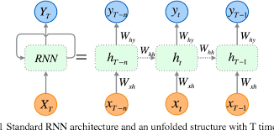

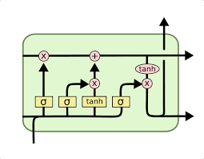
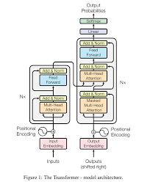
Related Work
RNN
LSTM
Transformers

Slide 7
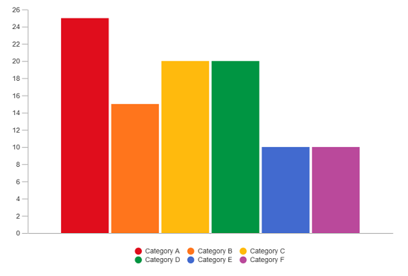
Approach
Undersampling
Question generation
CoQA Dataset Augmentation

Slide 8
Approach
Passage
Undersampling
Question generation
CoQA Dataset Augmentation
Q/A Generator
Question
Answer
Filter
Under-represented Question-Answer Pairs

Slide 9
Approach
Undersampling
Question generation
CoQA Dataset Augmentation
CoQA Dataset
SQuAD Dataset

Slide 10
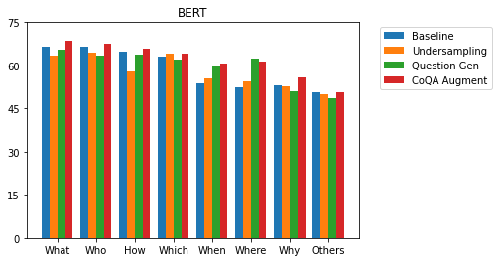
Results
Notes:
Undersampling -> [What , Who , How] decrease in accuracy because of high undersampling, [Which , When , Where] in and around the baseline due to fair share of questions during training.
Question Generation -> Minimal changes to metric for [What , Who , How] since we didn’t really add too many questions for that. [Which , When , Where] slight improvement. [Why] Generation method - Hard to generate.
COQA -> Improvement everywhere. More similar examples for each.

Slide 11
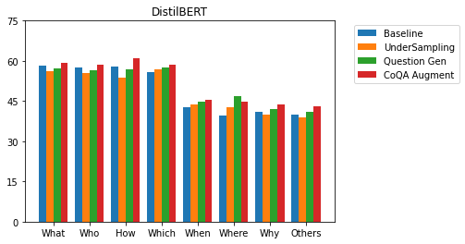
Results

Slide 12
References
[1] Rajpurkar, Pranav, et al. "Squad: 100,000+ questions for machine comprehension of text." arXiv preprint arXiv:1606.05250 (2016).
[2] Devlin, Jacob, et al. "Bert: Pre-training of deep bidirectional transformers for language understanding." arXiv preprint arXiv:1810.04805 (2018)
[3] Rajpurkar, Pranav, Robin Jia, and Percy Liang."Know what you don’t know: Unanswerable questions for SQuAD." arXiv preprint arXiv:1806.03822(2018)
[4] Y. Zhu et al., "Aligning Books and Movies: Towards Story-Like Visual Explanations by Watching Movies and Reading Books," 2015 IEEE International Conference on Computer Vision (ICCV), 2015, pp. 19-27, doi: 10.1109/ICCV.2015.11.
[5] Sanh, Victor, et al. "DistilBERT, a distilled version of BERT: smaller, faster, cheaper and lighter." arXiv preprint arXiv:1910.01108 (2019).
[6] Zhou, Qingyu, et al. "Neural question generation from text: A preliminary study." National CCF Conference on Natural Language Processing and Chinese Computing. Springer, Cham, 2017.
[7] Gupta, Suhas. "Exploring Neural Net Augmentation to BERT for Question Answering on SQUAD 2.0." arXiv preprint arXiv:1908.01767 (2019).
[8] Kwiatkowski, Tom, et al. "Natural questions: a benchmark for question answering research." Transactions of the Association for Computational Linguistics 7 (2019): 453-466.
[9] Choi, Eunsol, et al. "QuAC:Question answering in context." arXiv preprint arXiv:1808.07036 (2018).

